Slide 1

MMseqs 2
By: Kieran Lynch and Sierra Freytiz

Slide 2
What is MMSeqs2?
Open-Source software to cluster massive datasets
Highly optimized to utilize all computing resource
Maintains performance, but with a higher speed
400 times faster than PSI-BLAST
Various workflows to perform clustering
Able to cluster, align, and search

Slide 3
Why do we Cluster?
Data Management (simplifying to common group)
Noise / Error Reduction (similarity reduces chances of bad reads)
Biological Insights (OTU discovery)
Functional/Phylogentic Analysis (Create trees or sort by function)

Slide 4
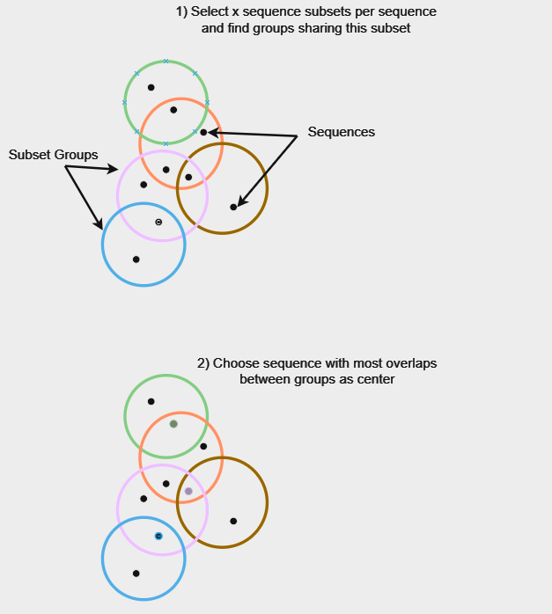
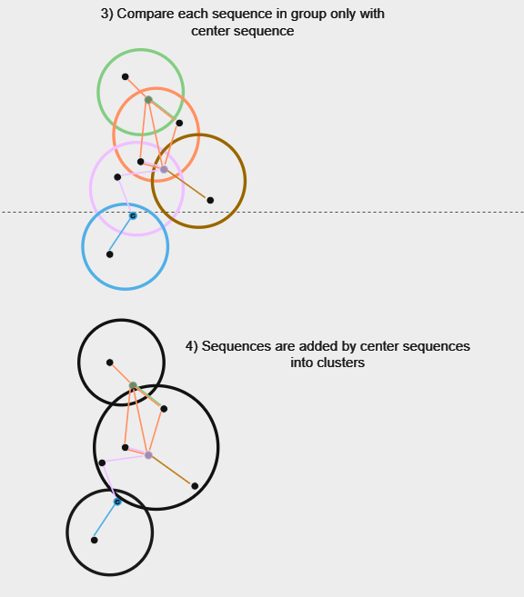
Single-Step Clustering Procedure

Slide 5
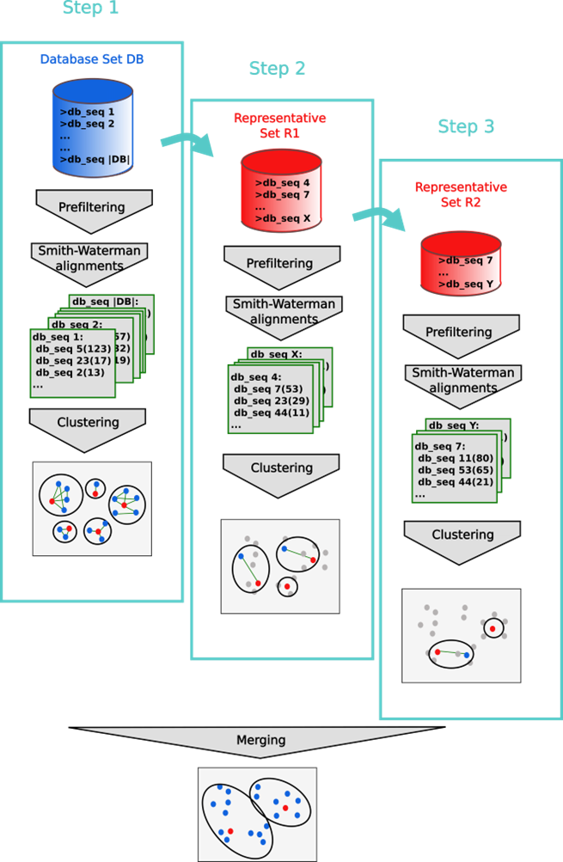
Cascade Clustering
First step: The prefiltering runs with a low sensitivity of 1 and a very high result significance threshold
Search only for hits with a very high sequence identity
Second step: Repeats the prefiltering, alignment and clustering steps with representative sequences of the first step
The prefiltering is executed with a higher sensitivity and a lower result significance threshold for catching sequence pairs with lower sequence identity
Third step: Whole process is repeated with the final target sensitivity
Final step: Clustering results are merged, and the resulting clustering is written to the output database

Slide 6
Cascade vs. Single-Step Clustering
Cascade
Iterative approach, one iteration feeds another
Able to refine clusters
May be more computationally expensive
Single-Step Clustering
Clusters in one go
More efficient
Clusters may not be as refined as cascade

Slide 7
Linking Criteria
Three main local alignment criteria to link two sequences by an edge:
A maximum E-value threshold computed
A minimum coverage, which is defined by the number of aligned residue pairs divided by either the maximum of the length of query/centre and target/non-centre sequences , or by the length of the target/non-centre sequence, or by the length of the query/centre
A minimum sequence identity defined as the number of identical aligned residues divided by the number of aligned columns including internal gap columns

Slide 8
Downloading MMseqs
git clone https://github.com/soedinglab/MMseqs2.git
-> Clones the github repository to your picotte account
cd MMseqs2
mkdir build
cd build
cmake -DCMAKE_BUILD_TYPE=RELEASE DCMAKE_INSTALL_PREFIX=. ..
make
make install
-> Configures the installation of the mmseqs binary file
export PATH=$(pwd)/bin/:$PATH
-> Sets the env variable so you can simply use “mmseqs” to run commands

Slide 9
Downloading Data
wget https://mothur.s3.us-east-2.amazonaws.com/wiki/miseqsopdata.zip
-> Downloads the sequence data to your current directory
unzip miseqsopdata.zip
-> Unzips the data creates a new directory
Success if you see this directory!

Slide 10
Using the createdb command
Mmseqs requires files in its own “DB” format
Must convert fasta/q files
Directory created with internal similarity information
Eliminates need to read multiple files
mmseqs name
createdb command
Input File
Database Name
mmseqs createdb combined.fastq fastqDB

Slide 11
Using the cluster command
Clusters an input database
Temp directory stores intermediate calculations
Can query output database to see results
Input DB
Cluster DB
Command Name
Temp directory
mmseqs name
Single Step Clustering (optional)
mmseqs cluster fastqDB DB_fastq_clu fastq (--single-step-clustering)

Slide 12
Clustering Modes
--cluster-mode 0 (Greedy Set Cover)
Creates compact clusters, each member has direct connection to centroid
--cluster-mode 1 (Connected Component)
Captures more distant similarities, at the expense of computational resources
--cluster-mode 2 (Greedy Incremental)
Prioritizes efficiency by clustering from longest to smallest
--cluster-mode 3 (LinClust)
Achieves linear-time complexity, ideal for very large datasets.

Slide 13
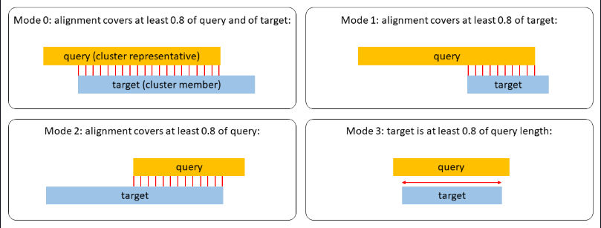
Clustering Coverage
--cov-mode {num}
num = 0
Target and Sequences can overlap
num = 1
Coverage search starts at beginning of target
num = 2
Coverage search starts at beginning of query
num = 3
Target has at least 0.8 length of query sequence

Slide 14
Clustering Parameters
-c [0,1]
Specifies that only sequences with coverage > c should be clustered (default 0.8)
--min-seq-id [0,1]
How similar sequences must be to be clustered together (Doesn’t filter by sequence identity by default)
-e [0,\infty]
Factors out chance matches (0.1 by default)
-s [1,7.5]
Affects how many k-mers are used in similarity searching

Slide 15
Cluster Output to TSV
There are a variety of ways to get output
I.e. FASTA, internal cluster, representative sequence
Chose TSV for easy side by side comparison
All formats have same parameters, but slightly different commands
Input DB
Input DB
Command name
Cluster DB
mmseqs name
Output TSV
mmseqs createtsv fastqDB fastqDB DB_fastq_clu DB_fastq_clu.tsv

Slide 16
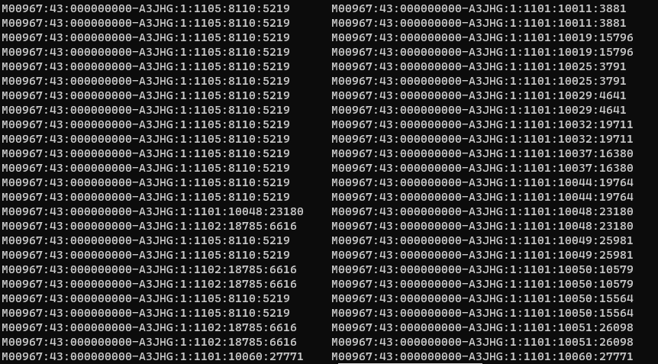
Fastq Comparison
304720 nucleotide sequences were clustered
Same database was used to cluster
Bash script was used to compare clusters
569 clusters created
Sequence
Cascade
Centroid
Single Step
Centroid

Slide 17
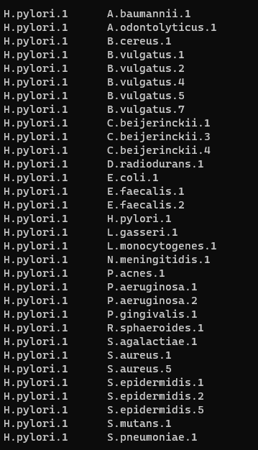
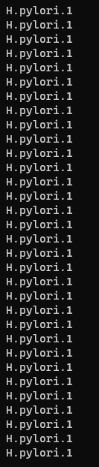
Fasta Comparison
Identical Centroids
Similar run-times
Only 15 records clustered
Sequence
Single-Step Centroid
Cascade Centroid

Slide 18
Clustering Deep Dive
 | Single Step Clustering (time s) | Cascade Clustering (s)
Fasta (15 sequences) | 57.889 | 55.195
Fastq (302740 sequences) | 159.06 | 169.66
The speedup is noticeable in databases with more sequences
Smaller FASTA file yields negligible benefits
Better to use cascade clustering for smaller datasets
Default parameters were used

Slide 19
Concluding Remarks
Methods for clustering files from various sources
High level of customization in controlling the sensitivity vs speedup tradeoff
Scalability, allows for generalization to some of the larger datasets.

Slide 20
Sources
Steinegger, M., Söding, J. Clustering huge protein sequence sets in linear time. Nat Commun 9, 2542 (2018). https://doi.org/10.1038/s41467-018-04964-5
Steinegger, M., Mirdita, M., Levy Karin, E., von den Driesch, L., Galiez, C., and Söding, J. “MMseqs2 User Guide.” GitHub. Accessed February 13, 2024. https://github.com/soedinglab/MMseqs2/wiki#cascaded-clustering.

